Slide 1
CUSTOMER CHURN ANALYSIS
-Presented By
DEEKSHA R

Slide 2
Project introdutcion
Analyzing Customer data of North American Bank as the bank is not performing great.This analysis will help to evaluate and understand about customers behaviour and pattern with regards to those who have stopped purchasing their services in order to further prevent any loss of customers.

Slide 3
IMplementation of project
Define and Plan -----> Analysis -----> Present & Document
1. Define and Plan: This step involves understanding the project's goals, objectives.
2. Analysis: This step involves collecting and preprocessing data, exploring and understanding the dataset.
3. Present and Document: This step involves documenting the project's process and creating a presentation or report to communicate the findings and outcomes.

Slide 4
DESCRIPTION OF DATASET
1.The dataset tells about credit card customers, with their demographic details and banking activities.
2.The dataset includes customer age, gender, education level, marital status, income category, region, and other variables.
3.It also contains banking-related information, such as months on book, total relationship count, credit limit, transaction details, and utilization ratios.
4.This dataset can be used for analyzing the customers and their behaviors.

Slide 5
Data Pre-processing
First step ,the data was loaded and read into python using pandas library.
Statistically summary to know about the aggregation values
Identifying missing values
Data Imputation with the help of modal value as it is best suited for categorical data type

Slide 6

Template
Created a template for dashboard using Figma in accordance with
the charts for visualizing and better understanding.

Slide 7

INteractivity
Created a handler in order to control all the sheets in dashboard and added a common filter for all the charts to be controlled under as one and uniformly.

Slide 8
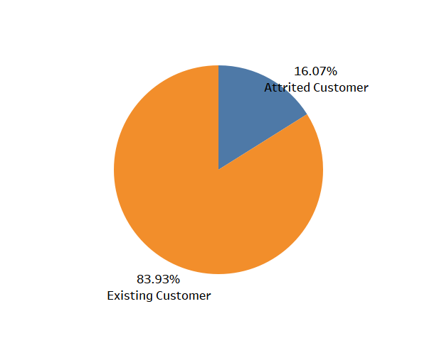
Task 1
Question:
Display the % of existing and attrited customers
Conclusion:
Percentage of existing customers is higher at 83%

Slide 9
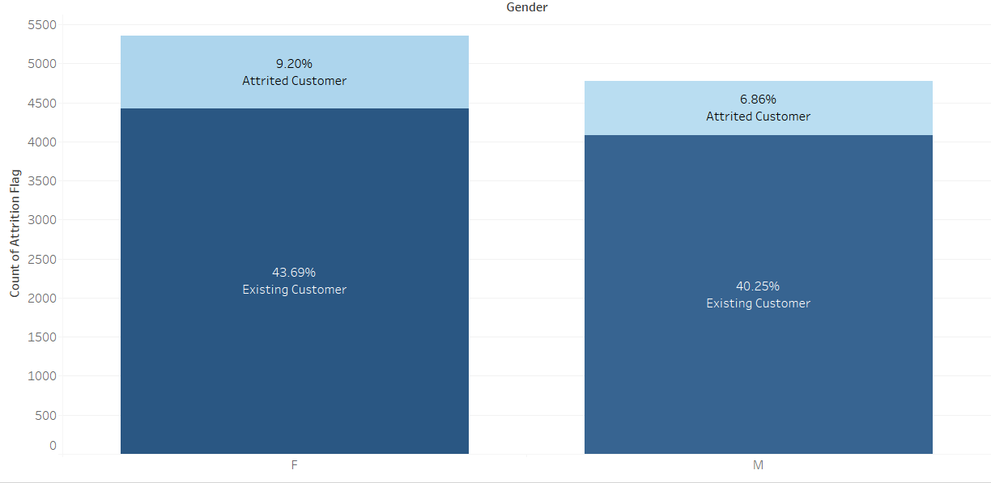
Task 2
Question:
Display the gender wise % of existing and attrited customers
Conclusion:
Overall female cutomers are more than male

Slide 10
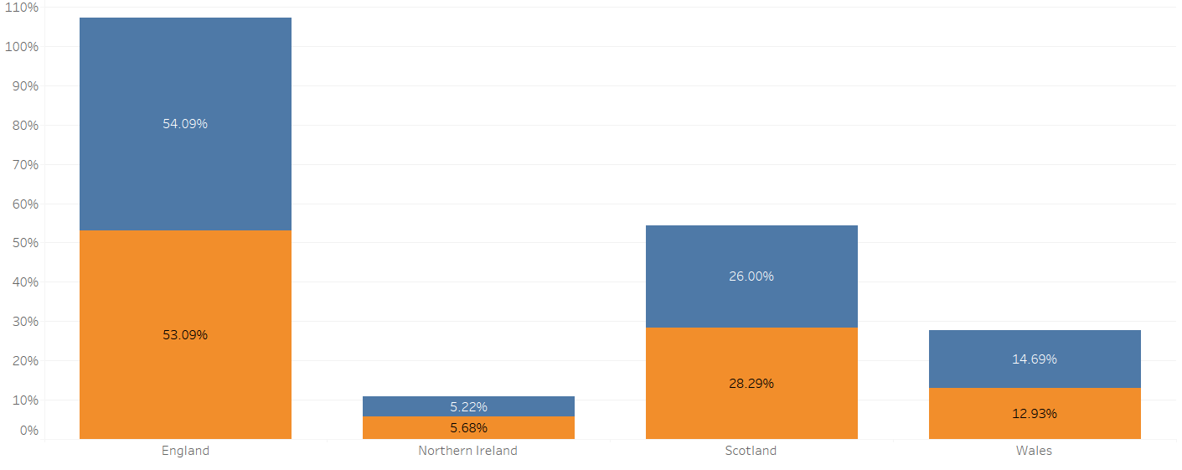
Task 3
Question:
Display the region wise % of existing and attrited customers
Conclusion:
Both attrited and existing customers are more in England

Slide 11
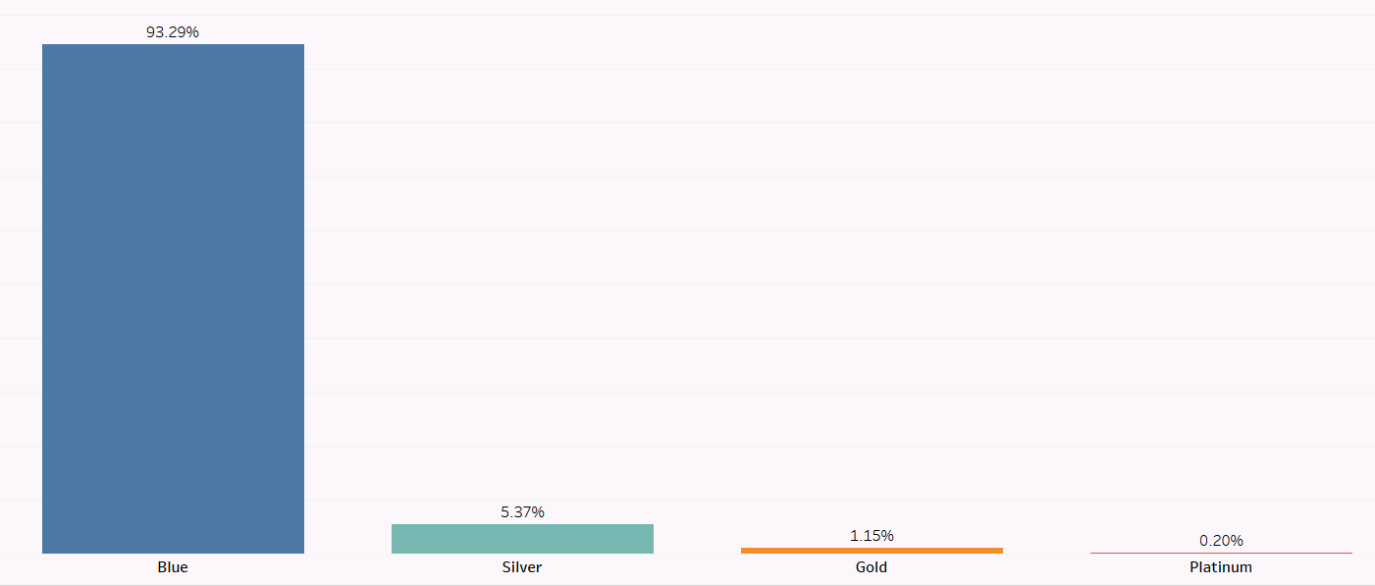
Task 4
Question:
Display the % of existing and attrited customers for each card category
Conclusion:
Most customers belong to Blue card category

Slide 12
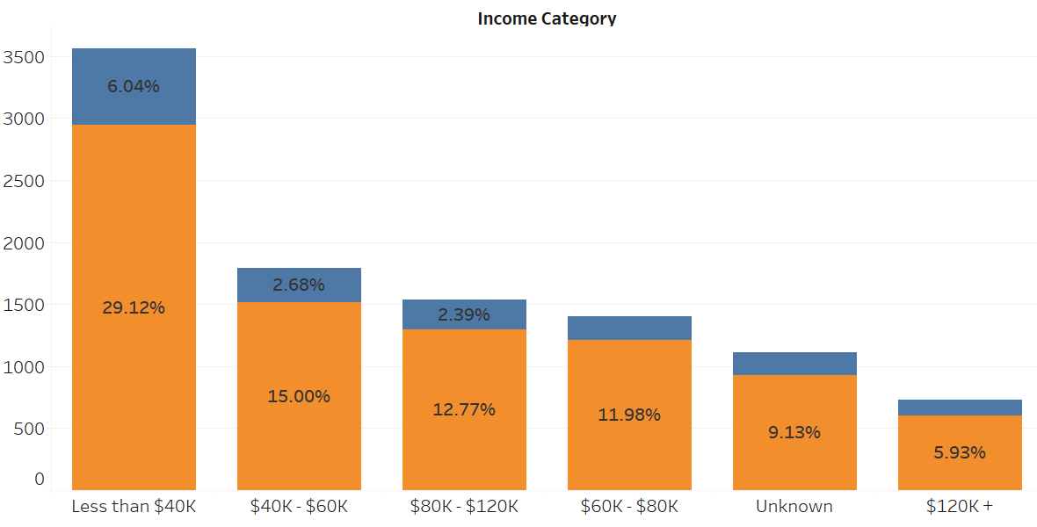
Task 5
Question:
Display the % of existing and attrited customers for each income category
Conclusion:
Overall in all category existing customers are more in all types of income group. The highest is in the category of Less than $40K

Slide 13
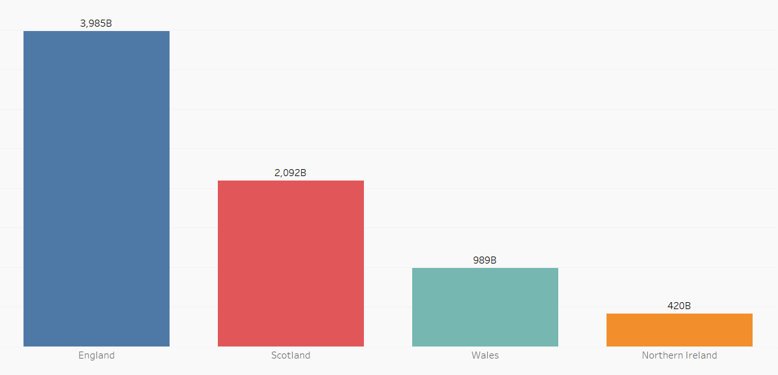
Task 6
Question:
Display the region wise count of customers. Identify the region with maximum number of customers
Conclusion:
England has the highest no.of customers

Slide 14
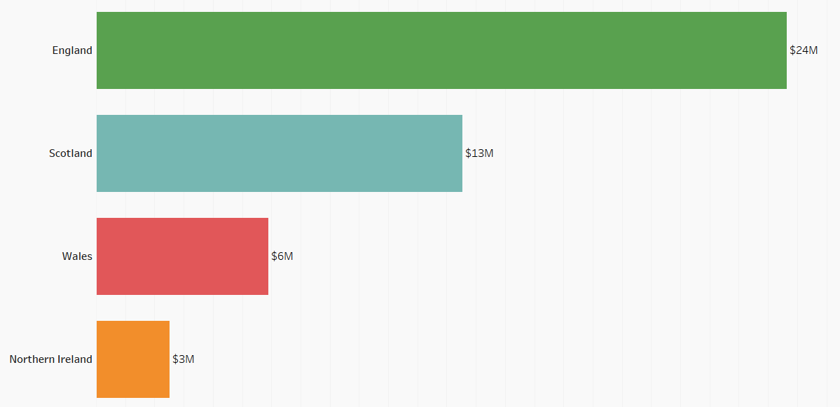
Task 7
Question:
What is the Region wise sum of total transaction amount
Conclusion:
Most spending region is England . It transaction amounts to around $24M.

Slide 15
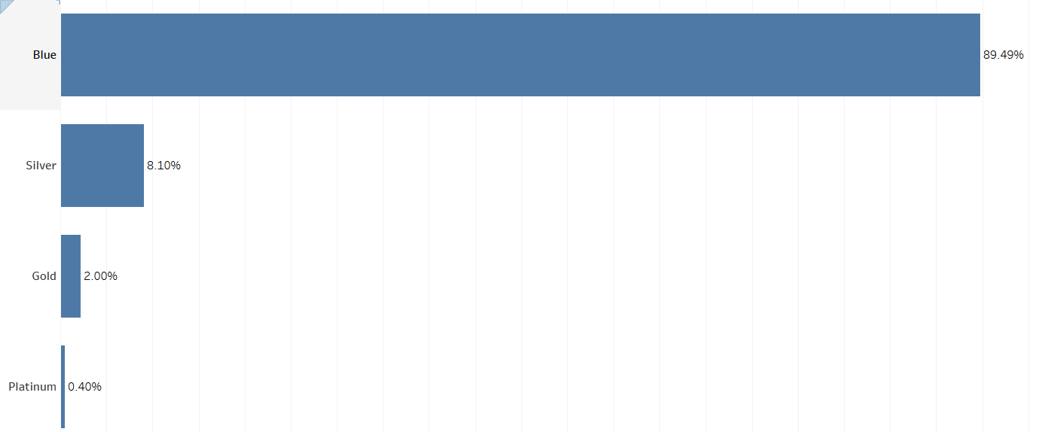
Task 8
Question:
which card category is used the most with respect to the total transaction amount?
Conclusion:
Mostly used card is blue type catgeory with about 89% of people use it.

Slide 16
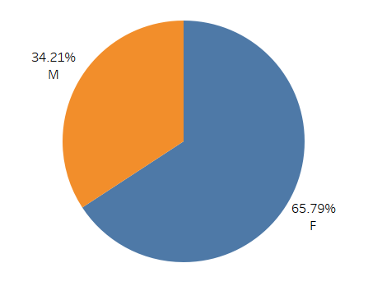
Task 9
Question:
What is the genderwise utilization ratio for cards?
Conclusion:
Female have higher utilization ratio

Slide 17
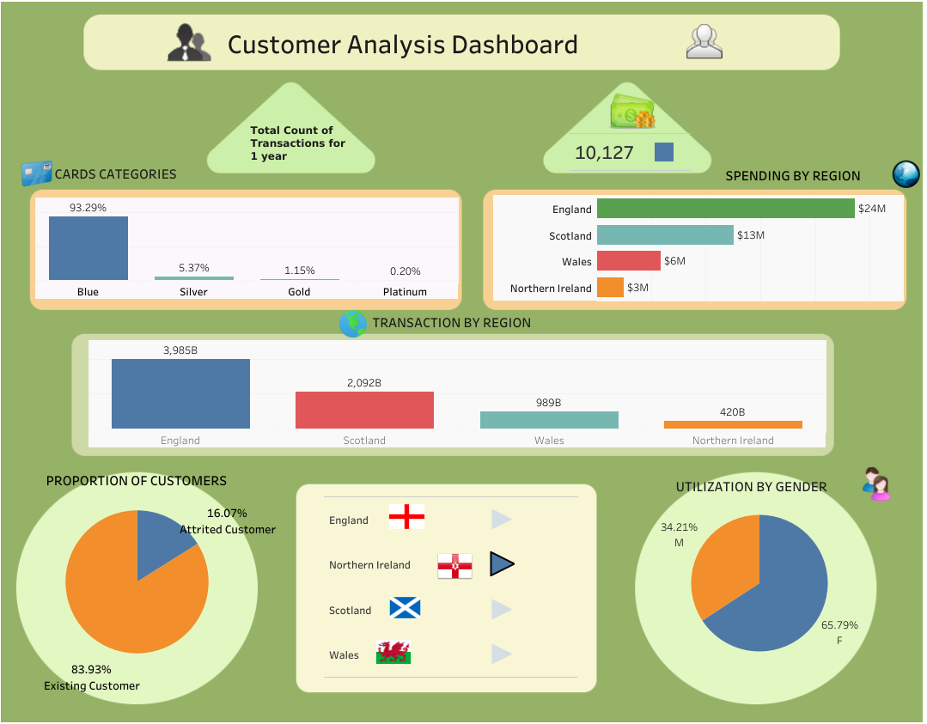
DAshboard
TASK 10

